Slide 1
Robotic, Laparoscopic and Open Surgery for Gastric Cancer Compared on Surgical, Clinical and Oncological Outcomes: Establishing a Multi-Institutional Registry
IMIGASTRIC
International study group on Minimally Invasive surgery for Gastric Cancer
Project Manager: Amilcare Parisi

Slide 2
Department of General Surgery, Jinling Hospital, Medical School, Nanjing University. Nanjing, P.R.China.
PI: Zhi-Wei JIANG
Co-Investigator: Shu ZHANG
Department of Surgery, Ruijin Hospital, Shanghai Jiaotong University, School of Medicine. Shanghai, P.R. China.
PI: Lu ZANG
Co-Investigator: Junjun MA
Department of General Surgery, Third Military Medical University Southwest Hospital. Chongqing, P.R. China.
PI: Pei-Wu YU
Co-Investigators: Ben ZHANG, Yong-Liang ZHAO
Gastrointestinal Surgery, Tianjin Medical University General Hospital. Tianjin, P.R. China
PI: Feng QI
Co-Investigator: Tong LIU
Department of Surgery, National Defense Medical College. Tokorozawa, Japan.
PI: Hironori Tsujimoto
Department of Gastroenterological Surgery, Osaka University Graduate School of Medicine. Osaka, Japan.
PI: Yukinori Kurokawa
Co-Investigator: Shuji Takiguchi
Department of General Surgery, School of Medicine, Istanbul Medeniyet University. Istanbul, Turkey.
PI: Orhan Alimoglu
Co-Investigator: Tunc Eren, Metin Leblebici
Notes:
The following presentation summarizes the challenging work that was undertaken for the conception, design, and development of the Imigastric project up to the official opening of the international registry along with future perspectives.

Slide 3
Department of Digestive Surgery, St. Mary’s Hospital, University of Perugia. Terni, Italy.
PI: Amilcare Parisi
Co-Investigators: Jacopo Desiderio, Stefano Trastulli, Roberto Cirocchi
Chirurgische Klinik und Poliklinik, Klinikum Rechts der Isar der Technischen Universität München. München, Germany.
PI: Daniel Reim
Co-Investigators: Alexander Novotny
Division of Oncological and Robotic Surgery, Department of Oncology, Careggi University Hospital. Florence, Italy.
PI: Andrea Coratti
Co-Investigators: Mario Annecchiarico
Unité des Maladies de l’Appareil Digestif et Endocrine (UMADE), Centre Hospitalier de Luxembourg. Luxembourg.
PI: Juan-Santiago Azagra
Co-Investigators: Martine Goergen
Service de chirurgie digestive et cancérologique CHU Bocage. Dijon, France.
PI: Olivier Facy
Co-Investigators: Jean-Baptiste Lequeu
Department of General Surgery, Division of General, Gastroenterologic and Minimally Invasive Surgery, G.B.Morgagni Hospital. Forlì. Italy.
PI: Francesca Bazzocchi
Co-Investigator: Andrea Avanzolini
Digestive and Hepatobiliary Surgery Department. University of Auvergne, University Hospital Estaing. Clermont-Ferrand, France.
PI: Johan Gagniere
Co-investigators: Denis Pezet, Olivier Antomarchi
Unit of minimally invasive and endocrine surgery, Center of oncologic minimally invasive surgery (COMIS), Careggi University hospital. Florence, Italy.
PI: Fabio Cianchi
Co-Investigators: Benedetta Badii
Esophageal Surgery Unit, Tuscany Regional Referral Center for the Diagnosis and Treatment of Esophageal Disease, Medical University of Pisa. Pisa, Italy.
PI: Simone D’Imporzano
Department of General Surgery, A.S.O. Santa Croce e Carle. Cuneo, Italy.
PI: Felice Borghi
Co-investigators: Alessandra Marano

Slide 4
Division of General Surgery, Sunnybrook Health Sciences Centre. Toronto, Canada.
PI: Natalie G. Coburn
Department of Surgery, Division of Gastrointestinal Surgery, University of California, Irvine Medical Center. Orange CA, USA.
PI: Ninh T Nguyen
Division of General Surgery, Division of Surgical Oncology, Medstar Georgetown University Hospital. Washington DC, USA.
PI: Patrick G. Jackson
Co-Investigator: Waddah Al-Refaie
Department of Surgery, Mount Sinai Beth Israel Medical Center. New York NY, USA.
PI: Steven T. Brower

Slide 5
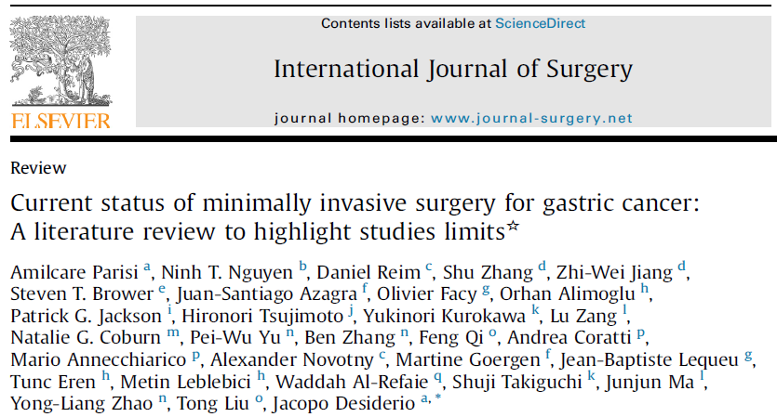
RATIONALE
Minimally Invasive Surgery
In Gastric Cancer
LAPAROSCOPIC SURGERY
ROBOTIC SURGERY
Safety demonstrated for EGC at referral centers
Technological advantages due to new articulated tools and 3D vision
Growing attention
Low Level of evidence
Notes:
Minimally invasive and gastric surgery are particularly fascinating due to their many areas of research and continual development, which deserves greater interest and requires further investigation.
Unfortunately, the studies carried out thus far have not clarified the role of laparoscopic or even robotic surgery, which prevents the scientific community from being able to develop specific guidelines.

Slide 6
RATIONALE
Main limits found in
current clinical studies
Small samples of patients, few high-quality comparative studies.
Selection bias in generating the comparative groups: stage of the disease, different extensive surgeries.
Lack of clarity in the description of anastomotic techniques
Results of intracorporeal anastomosis are often mixed with those of extracorporeal anastomosis.
Anastomotic leak rate, in some studies, was twice as high after MIS procedures than OG, but there is a lack of information on the method of reconstruction.
There are significant discrepancies between studies concerning the length of hospital stay and postoperative management of patients.
Notes:
The Imigastric project began from an accurate review of the scientific literature and was aimed at conducting a fuller analysis of the current situation regarding minimally invasive surgery for gastric cancer.
Significant limitations were found, including:
- Small samples of patients, mostly comparative studies of low quality
- Selection bias in the comparison groups (stage, extent of lymphadenectomy)
- Absence of subgroup analysis in significant research fields
- Lack of information on the surgical techniques adopted
These issues should be overcome by new research strategies.

Slide 7
RATIONALE
WHAT KIND OF STUDY?
Large sample of patients
CONSISTENCE
Detection of numerous surgical, clinical and oncological variables
CLARIFYING KEY ISSUES
Predetermined and standardized method of data collection and analysis.
ENSURING ACCURACY
Bringing together the experience of the East and West
REPRESENTATIVENESS OF DATA
A multicenter registry may represent the best research method
to assess the role of minimally invasive approaches in gastric cancer
Notes:
What kind of study could be helpful in this context?
Now, it is clear that what is required includes the following:
-Using a large sample of patients
-Collecting multiple variables, allowing the making of a comprehensive statistical report
-Standardizing the methodology to be adopted, which would increase accuracy
-Bringing together the experience of East and West to discover shared points
A large multicenter registry could therefore be the optimal way to clarify the actual role of minimally invasive surgery for gastric cancer. With this, a working basis for analyzing outcomes of interest and obtaining directions for guidelines and future study developments can be created.

Slide 8
METHODS
Recruitment Strategy
254 potential investigators were identified from the literature review
Invitation letter by the Department of Digestive Surgery “Dt. Mary’s Hospital” of Terni
All of the corresponding authors of the selected articles were contacted via e-mail
No valid E-mail address: senior investigator contacted
No response received: second e-mail sent one week later
No response, no other addresses: fax sent to the Institution
No response after 3 weeks: other listed investigator contacted
At the end of the search, 18 centers in 10 different countries worldwide provided positive feedback and agreed in taking part in the creation of a Multi-institutional database.
Notes:
Therefore, in April 2014, we started from the previously performed literature analysis to identify centers potentially interested in such a project.An invitation letter was sent to the corresponding authors of selected articles, and we then proceeded according to a pre-established plan, as highlighted in the graphic. Overall, a total of 254 e-mails and faxes were sent during the search. At the end of this screening period, 18 centers offered positive feedback, which resulted in their being potentially interested in participating in developing a shared project.

Slide 9
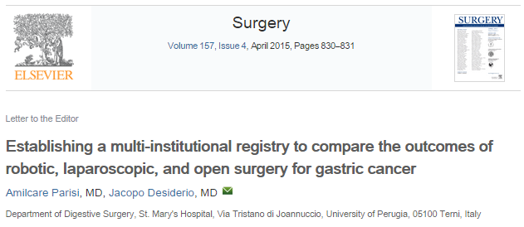
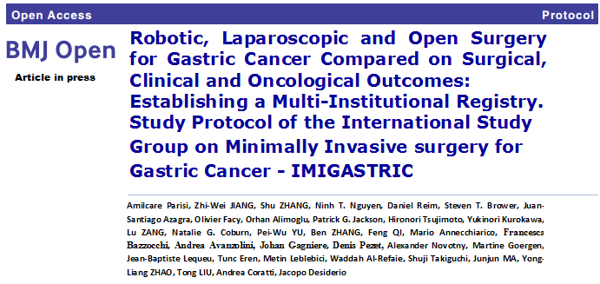
METHODS
Institutions reached
an agreement
Principles of the study
Objectives
Data to be collected
Software tools
Join databases
Compare all the current surgical approaches
Contribution on gastric cancer research
www.imigastric.com
DEVELOPMENT AND SHARING A STUDY PROTOCOL
Notes:
Over the following months, an agreement was reached on the study’s principles and objectives, the type of data to be collected, and the instruments to be adopted to make a truly valuable contribution to the scientific surgical research in this field. On this basis, a study protocol was subsequently developed. This phase successfully ended in December 2014 after a productive exchange of ideas and views among all involved researchers. During this period, 1,233 pieces of correspondence were sent via e-mail between the organizing secretariat and the participating investigators.
Today, the protocol is also being published in BMJ Open and will soon be available to readers. However, you can find a complete version of it on the study’s website. In addition, the study and Imigastric group were registered on clinicaltrials.gov. As such, an identification number was obtained, allowing researchers throughout the world to track our project.

Slide 10
METHODS
General study design
OVERALL PURPOSE
Develop and maintain an ongoing comprehensive multi-institutional database comprising of information regarding surgical, clinical and oncological features of patients undergoing surgery for gastric cancer with robotic, laparoscopic or open approaches and subsequent follow-up at participating centers.
The Main Objectives
To determine the surgical, clinical, and oncological outcomes in both the short and long term
To compare results according to the type of intervention, device used and manner of execution of different surgical phases
To relate results of different surgeries with baseline characteristics of patients and stage of disease
Notes:
The study’s overall objective is to establish and maintain a multi-institutional database comprising of information on the surgical, clinical, and oncological features of patients undergoing gastrectomy with a robotic, laparoscopic, or open approach.

Slide 11
METHODS
General study design
TYPE OF STUDY
Different steps with an increasing level of scientific evidence were planned.
First Step: Retrospective study – Chart Review
Data of subjects with gastric cancer treated at the participating centers. Information gathered will be obtained from existing records, diagnostic tests and surgical interventions description
Second Step: Prospective Trial
Enrollment will be opened to newly identified subjects into the registry upon diagnosis and treatment in a prospective manner.
Notes:
The project, which began in May, includes an initial retrospective phase, including data coming from a chart review of existing medical records. Then, from the experience accumulated during this phase, a prospective trial could begin.

Slide 12
METHODS
Specific aims
AIM 1: To compare robotic and laparoscopic surgery to the open approach in terms of safety and feasibility based on the intraoperative and postoperative outcomes.
AIM 2: To verify the respect of oncological principles through minimally invasive approaches in relation to the stage and location of the tumor by comparing results to open surgery.
AIM 3: To verify whether minimally invasive approaches ensure the same effectiveness as open surgery in terms of overall survival and disease-free survival.
AIM 4: To compare the three treatment arms regarding recovery of gastrointestinal function considering the outcomes measured during the postoperative hospital stay.
AIM 5: To compare the incidence, types and severity of early postoperative complications after gastrectomy by the three approaches according to the Clavien-Dindo classification system.
AIM 6: To compare the intracorporeal to the extracorporeal anastomosis to evaluate post-operative recovery and complications.
AIM 7: To verify whether robotic gastrectomy, compared to laparoscopic or open techniques, is capable of reducing postoperative surgical stress.
Notes:
Seven specific aims of interest have been identified, which are: comparing different surgeries in terms of intraoperative outcomes, assessment of the recovery of gastrointestinal functions, postoperative stays, and short- and long-term complications, verifying the respect to oncological principles, overall survival, and disease-free survival.

Slide 13
METHODS
Eligibility
Every patient is required to meet all of the
inclusion criteria and none of the exclusion criteria
Inclusion criteria
Histological proven grastic cancer
Preoperative staging work-up performed in accordance to international guidelines
Early Gastric Cancer
Advanced Gastric Cancer
Patients treated with curative intent in accordance to international guidelines
Patients with positive peritoneal cytology can be considered
Exclusion criteria
Distant metastases: peritoneal carcinomatosis, liver metastases, distant lymph node metastases, Krukenberg tumors, involvement of other organs
Patients with high operative risk as defined by the Americans Society of Anesthesiologists (ASA) score > 4
History of previous abdominal surgery for gastric cancer
Synchronous malignancy in other organs
Palliative surgery
Notes:
Patients are considered for the registry based on inclusion and exclusion criteria, as shown in the table.

Slide 14
METHODS
Data collection
Patient Demographics
Sex, age, BMI, ASA score, concomitant illness, previous abdominal surgery.
Surgical Procedure details
Type of surgical approach: open, laparoscopy, robotic
Gastric resection and type of reconstruction
Anastomosis approach: intra-corporeal, extra-corporeal
Anastomosis performance: linear stapler, circular stapler, hand-sewn, robot-sewn
Extent of lymphadenectomy: D1, D1+, D2, D2+
Duration of surgery, blood loss, intraoperative complications
Number of retrieved lymph nodes, margin free of disease or infiltrated.
Tumor characteristics
Tumor location: Upper third, Middle third, Lower third.
Depth of invasion (T classification), lymph node status (N classification), AJCC pathological stage, Histological type and Lauren classification
Notes:
For data collection, six categories were identified:
-patient characteristics
-surgical procedure details
-tumor characteristics

Slide 15
METHODS
Data collection
Post-operative clinical findings
Time to start oral intake
Resumption of bowel function
Length of postoperative hospital stay
Post-operative complications
Type and grade of in-hospital complications
Surgical complications after discharge
Follow-up details
Patient alive, not alive or lost at follow-up
Disease-free or not at follow-up
Time to onset of recurrence and site of recurrence
Notes:
-Data concerning the postoperative period
-Surgical complications
-Details of oncological follow-up

Slide 16
METHODS
Primary outcome measures
Safety and feasibility of MIS: rate of intraoperative complications, rate of conversion to open surgery, estimated blood loss.
Respect of oncological principles: number of lymph nodes retrieved and rate of patients achieving R0 resection, at the histopathological analysis of the surgical specimen.
Effectiveness of surgery: overall survival and disease–free survival achieved at 1, 3, 5 years from surgery.
Notes:
From the collected data, seven outcomes will be calculated and compared.
Three are primary outcomes: concerning safety and feasibility, respect of oncological principles, and surgical effectiveness.

Slide 17
METHODS
Secondary outcome measures
Recovery of gastrointestinal functions: time to peristalsis, time to first flatus, time to start oral intake and days of hospitalization after surgery until discharge.
Early postoperative complications: rate of total complications, rate of specific surgical complications, severity of complications scored on the
Clavien-Dindo classification system, assessed during hospitalization.
Safety and efficacy of intracorporeal anastomosis: rate of anastomotic leakage, days of hospitalization after surgery until discharge.
Postoperative surgical stress: Granulocyte-to-lymphocyte ratio recorded and compared before and after surgery.
Notes:
Four are secondary outcomes: analyzing the postoperative hospital stay, the severity of complications, the role of intracorporeal procedures, and the surgical stress.

Slide 18
METHODS
Study period and sites
The chart review for the registry takes into account all available data of patients treated at the participating Centers between the 1st January 2000 and the official opening of the Registry (14th May 2015).
The study started at the original 18 sites.
Other centers can join the study.
Notes:
The study considers data of patients treated from January 1, 2000, to the official opening of the registry on May 14, 2015.
The initial institutions are already entering data, but the registry is open to other interested institutions.

Slide 19
ETHICAL ASPECTS
All Investigators agree the study is conducted in compliance with ethical principles originating from the Helsinky Declaration, with the guidelines of Good Clinical Practice (GCP) and with applicable laws.
Investigators shall undertake to act according to the rules of the Institutional Review Board (IRB) and Ethics Committee (EC) regarding the retrospective collection of data.
SAFETY MANAGEMENT
Risks of a breach of confidentiality of the medical record information and associated privacy of the participants. Such risks will be minimized by the use and the establishment of appropriate tailor-made systems.
The organizing committee will ensure that confidential information will be secured and that Protected Health Information (PHI) will not be revealed.
Notes:
Each investigator must follow the rules of his or her institute concerning data collection.

Slide 20
TOOLS
The imigastric software
Standardize data collection
Avoiding transmission errors
Security of sensitive data
PROTECTED WEB SOFTWARE
Automatic statistics
Managing entered cases
Sharing
of data
Notes:
The most important innovation introduced in this type of study concerns the adopted tools. An IT instrument was created thanks to close cooperation with experts in software development. Combining medical and engineering expertise led to the development of a unique and tailored instrument. This makes it possible to facilitate and standardize data collection, speed up the creation of a shared database, and ensure the security of sensitive data. This system is accessible continually from anywhere in the world.

Slide 21
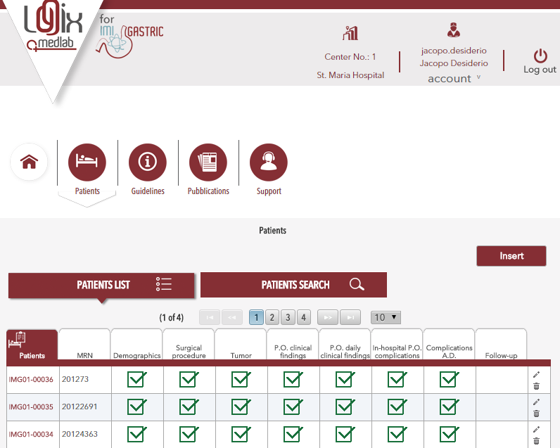
TOOLS
The imigastric software
The IMIGASTRIC software is an ERP (Enterprise Resource Planning) advanced system structured with specific sections dedicated to clinical data management and implementing processes.
The platform was designed by balancing the exigency to implement the application according to "Good Clinical Practice" and the need it is user friendly and safe.
Various access profiles (user, administrator), each of which are authorized to display specific information for tailored management.
Notes:
The creation of a multi-institutional registry leads to many problems needing to be addressed.
The investigators reside in different parts of the world. As such, there is a high risk of transmission errors’ being generated during the various steps of collecting and sending data. Therefore, the main purpose was to make data entry and sharing extremely fast and user friendly.
The software has some principal characteristics, such as having different levels of user profiles, being independently managed by each center, collecting all data in a global registry, and being able to obtain statistics about your center and from the overall database.

Slide 22
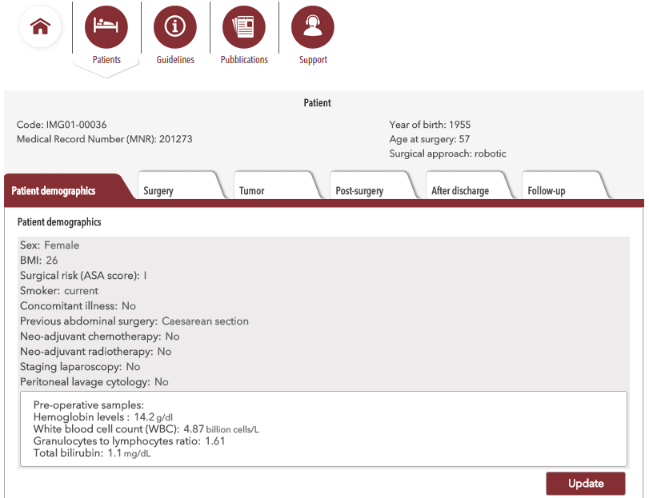
TOOLS
The imigastric software
Advanced software technology: complete management of the IMIGASTRIC registry in RDE (Remote Data Entry) mode, possible by exploiting broad band (ISDN, ADSL) Internet connection.
Any activity required by investigators can be performed through an application available online and accessible via a specific Internet address.
Through the activation of particular analysis tools, it is possible to obtain data in real time.
Assurance of data quality and safety. Monitoring of the quality of data written in electronic formats.
Notes:
Moreover:
1. Data entry of patient information complies with the most stringent privacy regulations; sensitive data are not recorded on a server, but the software generates a reference code.
2. For each patient, the system generates an IT folder containing six specific areas to complete.
3. The software is designed to guide the user in data entry, thus avoiding the generation of errors.
4. The different fields are filled in by selecting the various options from drop-down menus available for each parameter. All characteristics to be entered have been previously standardized, without the need to write or specify anything else when filling in the fields. Any considered variable derives from an analysis of all the data reported in previous studies found in the literature and in accordance with accepted guidelines.
5. In addition, the software uses predefined control instruments and automatic calculations.

Slide 23
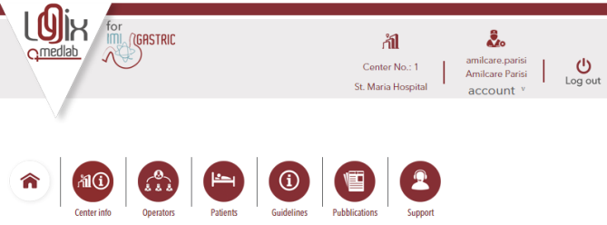
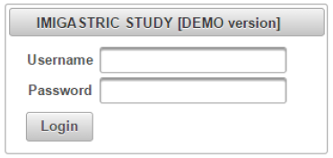
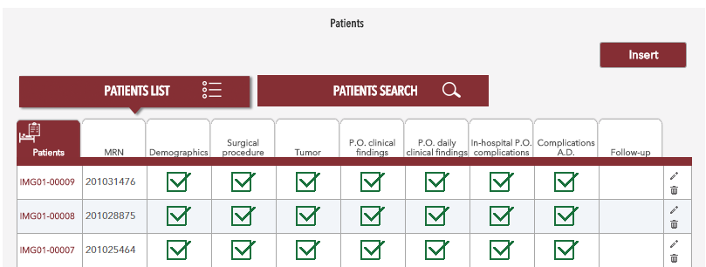
TOOLS
The imigastric software
Notes:
The engineering work for the development of the software was carried out in three phases:
1. Design of the web platform with the predisposition of all the fields to be considered for data entry (November 12, 2014–January 30, 2015);
2. Opening of the demo version to all participating institutions to allow for the sharing of this IT tool and to assess any changes and suggestions for improving the system (February 1, 2015–April 15, 2015) ;
3. (April 15–May 13) tweeking of the definitive working version of the software and acquisition of digital certificates and servers for data storage.
Finally, on May 14, just two months ago, centers officially began entering data. However, the registry is still open to other researchers that, if interested, can also try the Demo version of the software before deciding to join the Imigastric group.

Slide 24
PLANNED ANALYSIS
Data can be requested by all investigators to evaluate not only outcomes from the specific aims of the overall project but also other outcomes for their further studies.
A basic analysis for monitoring the study will be performed.
Continual updates will be available and can be done according to the investigator’s request.
Interim data analyses are planned with five scheduled reports, during the study period, to evaluate the primary outcomes.
Expected Scheduled Reports:
1st | 15 December 2015
2nd | 15 June 2016
3rd | 15 December 2016
4th | 15 June 2017
5th | 31 January 2018
Notes:
This registry is a tool that allows the research team to collect a large amount of information.
Data can be requested and used by all investigators to evaluate not only outcomes from the specific aims of the overall project but also other outcomes for their further studies.
All investigators can perform all the statistical analysis they need, while a basic analysis for monitoring the study will be performed as shown in the table.
Continual updates will also be available or can be done according to the investigator’s request.
Interim data analyses are planned with five scheduled reports, during the study period, to evaluate the primary outcomes.

Slide 25
FUTURE PERSPECTIVES
10 CENTERS
7 CENTERS
4 CENTERS
21 CENTERS
44 INVESTIGATORS
Notes:
As of today, an overall of 21 centers have taken part in the project, representing 10 countries spread across Asia, Europe, and North America, with a total of 44 investigators. The different centers are already entering data or are about to begin. As such, we expect to obtain an initial amount of data that could permit an analysis by early next year.

Slide 26
FUTURE PERSPECTIVES
FIND THE CONTACT FORM AT THE STUDY’S WEBSITE
Notes:
The maintenance of the registry is currently guaranteed until January 2018. At the end of this period, the system could continue to be active and, in any case, even after this period, the collected data will be made secure and available to all involved centers.
During the study period, other interested institutions can join the registry, thus increasing the size of the samples and allowing new statistical analyses.
In addition, it would be possible to open a prospective trial after sharing a specific protocol.

Slide 27
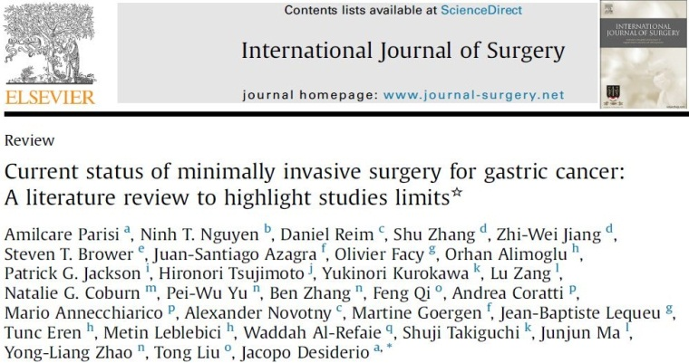
DISSEMINATION
CONGRESSES
ARTICALS
Notes:
For such a study, we realize that it is fundamental to come out and gain the credibility of the scientific community. To accomplish this, we must disseminate the goals of the research team and of the Imigastric project.
Therefore, we are moving on two fronts: publishing scientific articles and participating in international meetings.
The Imigastric group has already written three articles, the last of which concerns the study protocol, and it will soon be published.
At the same time, we are trying to promote the project and to sensitize the international scientific community.
Toward that end, it was an honor to present the project at the IGCA in Sao Paulo recently, where we displayed a poster of the study.
And today it was my pleasure to have had the opportunity to summarize the challenging work undertaken by the Imigastric group.

Slide 28
FINANCING OF THE STUDY
The IMIGASTRIC project is supported by CARIT Foundation (Fondazione Cassa di Risparmio di Terni e Narni), an organization that supports nonprofit research for the St. Mary’s Hospital of Terni and University of Perugia. Grant number: 0024137, approved 12/11/2014.
Notes:
The project earned a grant as a nonprofit study, provided by the CARIT Foundation, which will allow the registry to be kept open at least until the beginning of 2018.

Slide 29
MORE INFORMATION
www.imigastric.com
Notes:
We, along with all involved institutes, have done excellent work thus far, but we will only be rewarded for that work through future efforts.
You can obtain further information by visiting the study’s website at www.imigastric.com.
Contact information for the organizing secretariat and the coordinating staff is available there.
We invite interested researchers to join us.

