Slide 1
The Advancement of Minimally Invasive surgery in Gastric Cancer
Amilcare Parisi
Chief of the Department of Digestive Surgery,
St. Mary's Hospital, University of Perugia, Terni
Italy
1st China ERAS Congress, Jinling Hospital – Nanjing
July 10-12, 2015

Slide 2
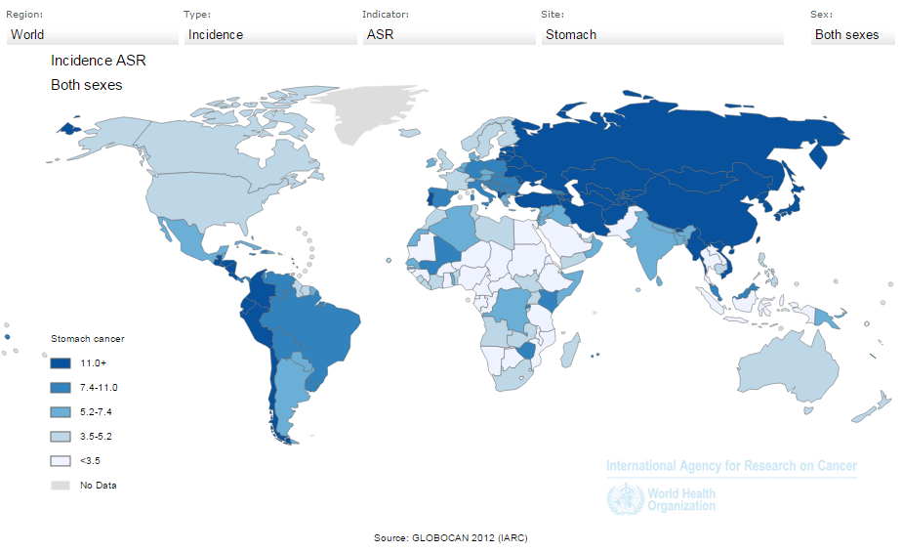
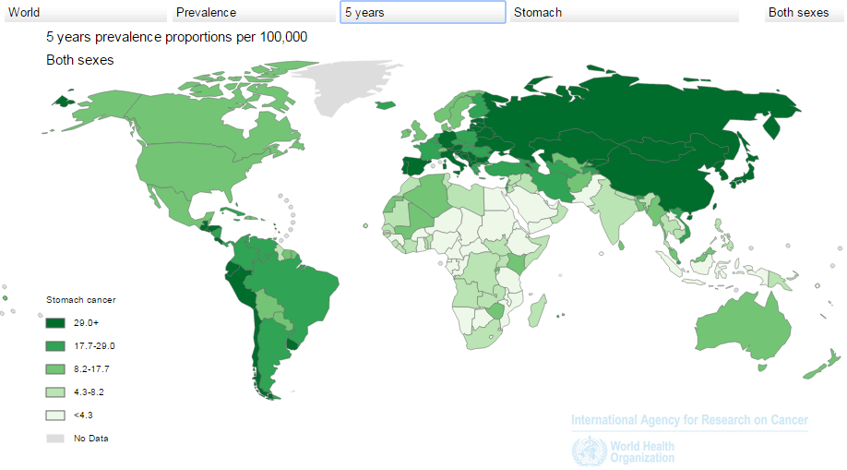
Gastric Cancer in the World
Gastric cancer is the fourth most common malignancy and the second leading cause of cancer death in the world.
Notes:
Gastric cancer is a major worldwide challenge, running rampant in some regions and overall representing the fourth most common cancer.

Slide 3
Current Practice
Multi-disciplinary
treatment planning
Surgical resection is the only curative treatment option
Standard Gastrectomy
resection of at least two-thirds of the stomach with a D2 lymph node dissection
Notes:
This disease requires a multidisciplinary context and dedicated institutes, where surgery plays the main role.

Slide 4
Investigation Fields
Endoscopic submucosal dissection under expanded criteria
Adjuvant chemotherapy using agents other than S-1
INVESTIGATIONAL TREATMENTS
Local tumor resection
Adjuvant chemoradiotherapy
Should be evaluated in appropriate clinical research settings
Neoadjuvant chemotherapy
Neoadjuvant chemoradiotherapy
Minimally Invasive Surgery
Notes:
Many current areas of research seek to identify the best treatment strategies. Thanks to our continuously evolving technology, minimally invasive surgery has become of increasing interest.

Slide 5
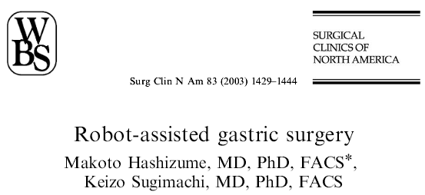
Minimally Invasive Surgery
Kitano firstly reported a laparoscopy-assisted distal gastrectomy for gastric cancer in 1994
Advancement of surgical techniques
Robotic-assisted gastrectomy was reported in 2003 by Hashizume
New surgical devices
Notes:
Kitano performed the first laparoscopic-assisted gastrectomy in 1994, and Hashizume first used the robotic approach in 2003. These and other surgeons at different centers have published articles on their experiences.

Slide 6
Overview
The number of laparoscopic gastrectomies is increasing
The benefit has only been shown by small comparative studies
Laparoscopy has been evaluated as an alternative to open surgery with the potential benefits of decreased operative morbidity and reduced recovery times
Meta-analyses confirm benefits in distal gastrectomy, though some concerns remain regarding long-term outcomes and the possibility for reduced nodal harvest
Robotic surgery is not even mentioned in the current guidelines
The evidence is still weak to be considered as standard procedures in daily practice
Notes:
Authors of several meta-analyses have sought to define the role of minimally invasive approaches for gastric cancer. However, the current evidence is far from able to prove these procedures should become common surgical practice. The current guidelines describe laparoscopy as a possible alternative to open surgery for early gastric cancer, while robotic surgery possesses intrinsic technological advantages, but researchers have not verified these advantages through studies with an appropriate level of evidence.

Slide 7
Overview
Perioperative outcomes
Quality of life
Research in Minimally Invasive Surgery
Respect of oncological principles
Growing attention in gastric cancer
Accuracy of the preoperative diagnosis
Surgeon’s experience and skill with MIS technology
Surgeon’s volume of gastrectomy procedure
Highlighted Issues
Reconstruction
Hospital’s volume
Extended lymphadenectomy
Notes:
Research in this field, in particular, seeks to assess the effects on perioperative outcomes along with the quality of the patient’s life, while still respecting oncological principles. The increasing attention researchers have paid to these approaches unfortunately comes up against the limited data currently available. Thus, many issues have become the subject of debate.

Slide 8
Robotic Gastrectomy: Skill
What skills can be improved with robotic technology?
The robotic surgery system facilitates the process of performing laparoscopic surgery and provides:
Three dimensional (3D)- image
An intuitive translation of the instrument handle to the tip movement, thus eliminating the mirror image effect.
Motion scaling
Tremor filtering
An internal articulated endoscopic wrist, providing an additional three degrees of freedom.
Coaxial alignment of the eyes, hands, and tool tip image.
This computer-enhanced surgical system thus allows surgeons to overcome various difficulties during endoscopic surgery:
Lymphadenectomy include
LN no. 8a, 9, 11p, 11d, 12a
Lymphadenectomy in obese and bleeding control
Isolation of diaphragmatic crura
Esophagojejunal reconstruction
Jiang ZW, Liu J, Wang G, Zhao K, Zhang S, Li N, Li JS: Esophagojejunostomy reconstruction using a robot-sewing technique during totally robotic total gastrectomy for gastric cancer. Hepatogastroenterology 2015, 62(138):323-326.
Kim MC, Heo GU, Jung GJ. Robotic gastrectomy for gastric cancer: surgical techniques and clinical merits. Surg Endosc 2010; 24:610-615.
Lee J, Kim YM, Woo Y, Obama K, Noh SH, Hyung WJ: Robotic distal subtotal gastrectomy with D2 lymphadenectomy for gastric cancer patients with high body mass index: comparison with conventional laparoscopic distal subtotal gastrectomy with D2 lymphadenectomy. Surg Endosc 2015.
Notes:
Robotic systems have revolutionized the way we perform minimally invasive surgery and have facilitated the evolution of traditional laparoscopy. With these, surgeons aim to overcome the limits of traditional laparoscopy through three-dimensional vision, articulated instruments, and the absence of tremor, which result in greater dexterity and precision in the movements of dissection and suturing. These are key elements when performing an extended lymphadenectomy for gastric cancer and a complex and gentle reconstruction to restore digestive continuity.

Slide 9
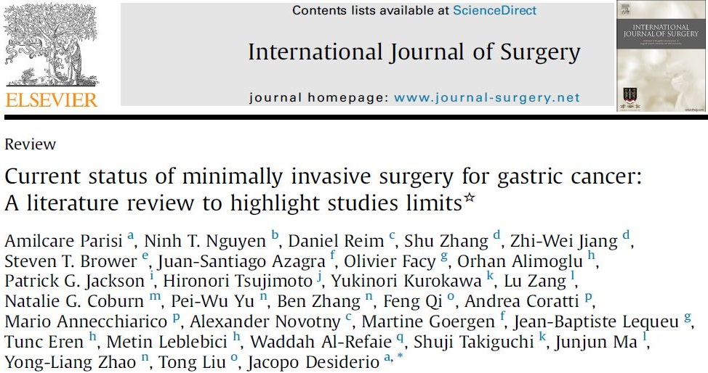
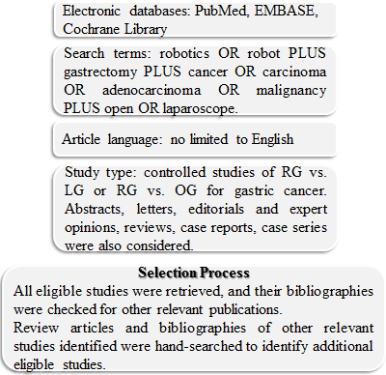
Current status: literature review
SEARCH STRATEGY
Notes:
To evaluate the current role of minimally invasive surgery, we performed, in the context of the IMIGASTRIC group, an analysis of published studies in the literature, identifying papers reporting experiences in laparoscopic and robotic gastric surgery.

Slide 10
Current status: literature review
LAPAROSCOPIC SURGERY
ROBOTIC SURGERY
Reports identified through database searching: 956
Reports excluded
by screening of title and abstract: 779
Reports excluded
by screening of title and abstract: 94
Reports identified through database searching: 133
Reports for abstract review: 177
Reports for abstract review: 39
Reports with no control group, mixed group of operations, reviews, letters,
editorials: 108
reports with control group: 38
reports with control group: 23
Reports with no control group, mixed group of operations, reviews, letters,
editorials: 16
RCTs: 6
NRCTs: 32
NRCTs: 23
RCTs: 0
TOTAL ARTICLES ANALYZED AND REVIEWED: 216
Notes:
We conducted the research in two ways, identifying all the articles on both laparoscopy and robotic surgery. The final report clearly highlights the difficulty of performing studies on this field. We found only six randomized controlled trials for laparoscopy and none for robotic surgery. Comparative studies were mostly of low quality, and long-term outcomes were unavailable or incomplete.

Slide 11
Literature review
Lymph-node dissection
Oncologic adequacy is the most critical issue when proposing a minimally invasive treatment for gastric cancer
LAPAROSCOPIC VS OPEN GASTRECTOMY
The retrieval of lymph nodes results significantly higher in the OG group by 3.9 nodes
(P < 0.001)
The odds of having less than 15 lymph nodes harvested is comparable
(P = 0.09)
Significant heterogeneity in lymphadenectomy type
(P < 0.001).
Adequate nodal pathological staging is not compromised by the laparoscopic technique.
The higher proportion of D2 dissections are in the OG group
D2 dissection is technically more challenging, and achieving a good extended laparoscopic lymph node dissection will require a steep learning curve.
Notes:
Researchers are currently debating several points, for example, the need to perform an adequate lymphadenectomy with minimally invasive techniques. Researchers still regard nodal clearance as an important factor influencing long-term survival. With laparoscopy, surgeons can feasibly remove at least 15 lymph nodes, but research has shown a statistically significant difference in favor of the open approach regarding the total number of retrieved lymph nodes.

Slide 12
Literature review
Lymph-node dissection
ROBOTIC SURGERY
 | TYPE | SAMPLES (NO.) | D2 PROCEDURES (NO.) | RETRIEVED LN (MEAN) | P VALUE
Kim KM | RG Vs LG Vs OG | 436 / 861 / 4542 | Not reported | 40,2 / 37,6 / 40,5 | <0,001
Huang | RG Vs LG Vs OG | 39 / 64 / 586 | 34 / 12 / 516 | 32 / 26 / 34 | <0,001
Caruso | RG Vs OG | 29 / 120 | 29 / 120 | 28 / 31.7 | 0,02
Kim MC | RG Vs LG Vs OG | 16 / 11 / 12 | 14 / 8 / 12 | 41.1 / 37,4 / 43,3 | 0,3
Patriti | RG Vs OG | 14 / 13 | 14 / 13 | 28,1 / 23,7 | NS
Pugliese | RG Vs LG | 31 / 25 | 31 / 25 | 18 / 52 | not reported
Woo | RG Vs LG | 236 / 591 | 105 / 279 | 39 / 37,4 | 0,3
Eom | RG Vs LG | 30 / 62 | 20 / 34 | 30.2 / 33.4 | 0,1
Hyun | RG Vs LG | 38 / 83 | 14 / 18 | 32,8 / 32,6 | 0,9
Junfeng | RG Vs LG | 120 / 394 | Not reported | 34,6 / 32,7 | 0,01
Kang | RG Vs LG | 100 / 282 | Not reported | Not reported | Not reported
Kim HI | RG Vs LG | 172 / 481 | 74 / 235 | 37,3 / 36,8 | 0,8
Noshiro | RG Vs LG | 21 / 160 | 8 / 81 | 44 / 40 | 0,2
Park | RG Vs LG | 30 / 120 | Not reported | 34 / 35 | 0,6
Son SY | RG Vs LG | 21 / 42 | 8 / 20 | 46,5 / 39,7 | 0,6
Son T | RG Vs LG | 51 / 58 | 51 / 58 | 47,2 / 42,8 | 0,2
Song | RG Vs LG | 20 / 20 | 4 / 10 | 35,3 / 31,5 | 0,3
Suda | RG Vs LG | 88 / 438 | 52 / 207 | 40 / 38 | 0,1
Uyama | RG Vs LG | 25 / 225 | 18 / 225 | 44,3 / 43,2 | 0,7
Yoon | RG Vs LG | 36 / 65 | Not reported | 39,4 / 42,8 | 0,2
Notes:
Robotic surgery could overcome the difficulties of traditional laparoscopy and allow a better D2 dissection. Clearly, this high technology possesses intrinsic advantages, but researchers have not yet proven and verified them. First, I must clarify that to evaluate the adequacy of the robotic procedure, researchers must use traditional open surgery for the main group of comparisons, not laparoscopy. The table highlights the inadequacy of the available data. Only five studies have made a comparison with the open approach, and only one study shows a statistically significant difference versus laparoscopy.

Slide 13
Literature review
Blood loss
Post-operative recovery
Relevant issue. It appears to correlate with surgical and oncological outcomes.
Cancer cell dissemination
Perioperative mortality
Lymphatic leakage
Perioperative morbidity
LAPAROSCOPIC SURGERY
ROBOTIC SURGERY
Estimated blood loss in LG group lesser than OG group, demonstrated by RCTs
(P < 0.001)
Patients staged IA – IIA¹: RG group had lesser EBL than LG group, especially for technically demanding LN stations. (93.25ml vs 173.45ml, P<0.001)
Elderly patients²: RG group had a smaller amount of EBL compared with LG group.
(101.4ml vs. 131.4ml, P=0.017)
1. Kang, B. H., et al. (2012). "Comparison of Surgical Outcomes between Robotic and Laparoscopic Gastrectomy for Gastric Cancer: The Learning Curve of Robotic Surgery." J Gastric Cancer 12(3): 156-163.
2. Junfeng, Z., et al. (2014). "Robotic gastrectomy versus laparoscopic gastrectomy for gastric cancer: comparison of surgical performance and short-term outcomes." Surg Endosc 28(6): 1779-1787.
3. Eom, B. W., et al. (2012). "Comparison of surgical performance and short-term clinical outcomes between laparoscopic and robotic surgery in distal gastric cancer." Eur J Surg Oncol 38(1): 57-63.
4. Son, T., et al. (2014). "Robotic spleen-preserving total gastrectomy for gastric cancer: comparison with conventional laparoscopic procedure." Surg Endosc.
Conflicting studies:
Eom³ (RG: 152,8ml vs LG: 88,3ml, P: 0,09)
Son⁴ (RG: 173,2ml vs LG: 116,6ml, P=0.014)
Notes:
Intraoperative blood loss correlates with postoperative recovery and cancer cell dissemination. Most studies reported favorable results for minimally invasive surgery versus open surgery. Vinuela’s meta-analysis clearly confirmed this as regards laparoscopic surgery. Generally, researchers have reported some advantages of robotic gastrectomy over laparoscopic or open surgery in reducing perioperative bleeding. However, several studies have also reported conflicting results.

Slide 14
Literature review
Complications
Decreased complications
Reduced invasiveness
Reduced hospital stay
LAPAROSCOPIC VS OPEN GASTRECTOMY
From the overall analysis of RCTs: LG is associated with a significant reduction in overall complications (P<0.001), medical complications (P=0.002) and minor surgical complications (P=0.001).
The current largest RCT (KLASS Trial) found no significant difference in the rate of complications between the laparoscopic and open approach
(P =0.13)
Kim, H. H., et al. (2010). "Morbidity and mortality of laparoscopic gastrectomy versus open gastrectomy for gastric cancer: an interim report--a phase III multicenter, prospective, randomized Trial (KLASS Trial)." Ann Surg 251(3): 417-420.
Major surgical complications are comparable between LG group and OG group.
No data related to long-term complications.
Notes:
Researchers found a connection between laparoscopy and a significant reduction in overall complications, medical complications, and minor surgical complications as compared to open surgery. They observed that major surgical complications occurred in comparable numbers for the two groups. The reduced invasiveness of the laparoscopic technique can explain the decrease in medical and minor surgical complications. In contrast, the largest randomized controlled trial that the Korean Laparoscopic Gastrointestinal Surgery Study Group performed found no significant difference between the two groups in overall complications.

Slide 15
Literature review
Complications
ROBOTIC VS LAPAROSCOPIC GASTRECTOMY
Hyun et al. reported the total complications, assessed by the C-D classification system, were not significantly different between the RG and LG groups (P = 0,36)
Park et al. showed postoperative complications occurred more frequently in the RG group than the LG group (17% vs 7,5%, P = 0,12), although most were minor and managed conservatively.
The RG group had a higher total number of complications than the LG group, but most of these complications were minor and could be treated nonsurgically.
The incidence of severe complications requiring an additional invasive procedure did not differ significantly between the groups (P=0,25).
The LG group had more major complications that required surgical, radiologic, or endoscopic intervention than the RG group.
Son et al. confirmed a similar incidence of postoperative complications in RG and LG (P = 0.37).
The severity was similar between the two groups (P = 0.88).
Hyun, M. H., et al. (2013). "Robot versus laparoscopic gastrectomy for cancer by an experienced surgeon: comparisons of surgery, complications, and surgical stress." Ann Surg Oncol 20(4): 1258-1265.
Son, T., et al. (2014). "Robotic spleen-preserving total gastrectomy for gastric cancer: comparison with conventional laparoscopic procedure." Surg Endosc.
Park, J. Y., et al. (2012). "Surgical stress after robot-assisted distal gastrectomy and its economic implications." Br J Surg 99(11): 1554-1561.
Notes:
Researchers have obtained inconsistent findings in studies on robotic surgery in terms of demonstrating significant differences compared to laparoscopy. However, a careful analysis is limited by the extreme heterogeneity of the surgical techniques adopted.

Slide 16
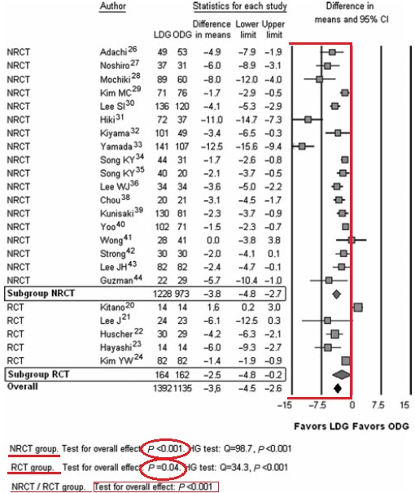
Literature review
Post-operative recovery
LAPAROSCOPIC VS OPEN GASTRECTOMY
A shorter hospital stay is observed in the LDG group (WMD = 3.6 days,
CI = 2.6–4.5, P < 0.001)
Significant heterogeneity is observed for this outcome in both RCTs and NRCTs
Notes:
Minimally invasive surgery has demonstrated relevant advantages over open surgery with regard to postoperative hospital stay, as shown in the forest plots, despite the extreme heterogeneity among studies.

Slide 17
Literature review
Post-operative recovery
ROBOTIC VS LAPAROSCOPIC VS OPEN GASTRECTOMY
Kim and Woo assessed that patients who underwent robotic gastrectomy could be discharged at an earlier date than patients who underwent open or laparoscopic gastrectomy.
Woo identified a significantly larger percentage of patients in the robotic group discharged by postoperative day 5 (48.8% of the LGS group vs. 61.0% of the RGS group; P = 0.04).
Notes:
Some evidence (Kim and Woo) has indicated that patients who underwent robotic gastrectomy could be discharged at an earlier date than patients who underwent open or laparoscopic gastrectomy. However, the low number of studies in this area and the high heterogeneity weaken this conclusion.

Slide 18
Literature review
Post-operative recovery
ROBOTIC VS LAPAROSCOPIC VS OPEN GASTRECTOMY
The smaller robot instruments may induce less inflammation than other approaches
Manually handling organs during gastrectomy is an important contributor to the inflammatory response
Postoperative bowel recovery in the robotic group may occur sooner
Robot-sewn intracorporeal anastomosis is feasible and permits small wounds that create less pain, increasing patients’ satisfaction.
Junfeng reported RGS is comparable to LGS regarding time of first flatus, days to eating a liquid diet, and length of hospital stay.
Song reported that patients in the RGS group tended to ambulate earlier, felt less pain, and were able to be discharged from hospital earlier.
Son showed postoperative restoration of bowel function, resumption of oral intake and hospital stay, were slightly in favor of laparoscopy.
Park reported that postoperative fluid discharge from the drain was reduced in patients who received RGS.
Kang reported significant longer average hospital stays in RGS group than LGS group (9.81 days vs. 8.11 days, P = 0.042).
Notes:
New studies must add to the literature and help to conclusively define the best surgical techniques. As Hiki observed, manually handling organs during gastrectomy is an important contributor to the inflammatory response after surgery. Theoretically, the smaller robot instruments may cause less inflammation than the instruments used in other approaches. Thus, postoperative bowel recovery in the robotic group may occur sooner.

Slide 19
Literature review
Reconstruction
The possibility of safely achieving intracorporeal anastomosis in place of extracorporeal procedures is currently being debated.
Advantages and limits have not been highlighted by current studies.
Robots can help surgeons because of the precise three-dimensional view and the instruments with seven degrees of freedom.
Hur H, Kim JY, Cho YK, Han SU. Technical feasibility of robot-sewn anastomosis in robotic surgery for gastric cancer. J Laparoendosc Adv Surg Tech A 2010; 20: 693-7.
Lack of scientific evidence
Notes:
Now I wish to focus our attention on a newly emerging and certainly more attractive technical development regarding the possibility of performing the reconstructive phase entirely with intracorporeal anastomosis. Together with the extent of lymphadenectomy, the restoration of the digestive tract remains one of the main areas of surgical research and now involves robotic systems.
In this context, robotic surgery may demonstrate a clear superiority as compared to laparoscopy. No researcher has yet studied this issue.
Some reports, like the one Prof. Jiang recently published and the one our group is publishing, are beginning to highlight the safety and feasibility of robot-sewn anastomosis for total gastrectomy and the relief of extremely satisfactory postoperative outcomes.

Slide 20
Literature review
Reconstruction
ROBOTIC TOTAL GASTRECTOMY
 | YEAR | TYPE | SUBJECT | COUNTRY | INSTITUTION | PERIOD | NO.
Jiang | 2015 | Retrospective CS | RAG | China | Nanjing University Medical College | 2010-2012 | 65
Kim KM | 2012 | nonRCT | RAG vs LG vs OG | Korea | Yonsei University College of Medicine | 2005-2010 | 109
Son T. | 2014 | nonRCT | RTG vs LTG
 |  |  |  |  |  | 2005-2010 | 51
Woo | 2011 | nonRCT | RAG vs LG |  |  | 2005-2009 | 62
Song | 2009 | Prospective CS | RAG |  |  | 2005-2007 | 33
Park | 2013 | Retrospective CS | RAG | Korea | National Cancer Center | 2009-2012 | 46
Yoon | 2012 | nonRCT | RTG vs LTG
 |  |  |  |  |  | 2009-2011 | 36
Kang | 2012 | nonRCT | RAG vs LG | Korea | Ajou University School of Medicine | 2008-2011 | 16
Hur | 2010 | Retrospective CS | RAG |  |  | 2010 | 2
Hyun | 2013 | nonRCT | RAG vs LG | Korea | Korea University Anam Hospital | 2009-2010 | 9
Son SY | 2012 | nonRCT | RAG vs LG | Korea | Seoul University Bundang Hospital | 2007-2011 | 1
Junfeng | 2014 | nonRCT | RAG vs LG | China | Third Military Medical University | 2010-2013 | 26
Liu | 2013 | Prospective CS | RAG | China | Subei People's Hospital of Jiangsu | 2011-2013 | 54
Giulianotti | 2003 | Retrospective CS | RAG | Italy | Misericordia Hospital of Grosseto | 2000-2002 | 10
Coratti | 2015 | Retrospective CS | RAG | Italy |  |  | 38
D’Annibale | 2011 | Retrospective CS | RAG | Italy | S. Giovanni Addolorata Hospital | 2004-2009 | 11
Caruso | 2011 | nonRCT | RAG vs OG | Italy | Hospital of Spoleto | 2006-2010 | 12
Suda | 2014 | nonRCT | RAG vs LG | Japan | Fujita Health University | 2009-2012 | 30
Huang | 2012 | nonRCT | RAG vs LG vs OG | Taiwan | Taipei Veterans General Hospital | 2010-2012 | 7
Vasilescu | 2012 | Retrospective CS | RAG | Romania | Fundeni Clinical Institute | 2008-2012 | 19
Zawadzki | 2014 | CR | RAG | Poland | Wroclaw Medical University | 2014 | 1
TOTAL |  |  |  |  |  |  | 444
Notes:
In the literature, only 21 studies of authors belonging to 15 institutions have reported a total gastrectomy performed using a robot-assisted approach.
Eleven studies are comparative. The remainder are case series and personal experiences. Only three studies (Son, Yoon, Jiang) focused specifically on total gastrectomy. Others reported data from and information on surgical interventions within more extensive analyses including different resection extents.
To date, scientific studies have presented an overall four hundred and forty-four (444) interventions of robotic-assisted total gastrectomy.

Slide 21
Literature review
Reconstruction
ROBOTIC TOTAL GASTRECTOMY
 | Robot - Assistance |  |  | Type | E-J Anastomosis | Anastomosis performance | Site of minilaparotomy | Operative /Clinical Data | Patient/ tumor details
 | Lymphadenectomy | Stomach mobilization | Reconstruction
Jiang | performed | performed |  | Roux-en-Y | EXTRA | Circular stapler | Not provided | provided | provided
 |  |  | Performed | Roux-en-Y | INTRA | Robot-sewn | Not provided
Kim KM | Not provided | Not provided | Not provided | Roux-en-Y | Not provided | Not provided | Not provided | lack | lack
Son T. | performed | performed |  | Roux-en-Y | EXTRA | Circular stapler | Upper midline | provided | provided
 |  |  |  | Roux-en-Y | INTRA LAP | Circular stapler | Left lower port
Woo | performed | performed |  | Roux-en-Y | EXTRA | Not provided | Not provided | lack | lack
 |  |  |  | Roux-en-Y | INTRA LAP | Not provided | Not provided
Song | performed | performed |  | Roux-en-Y | EXTRA | Circular stapler | Upper midline | lack | lack
 |  |  |  | Roux-en-Y | INTRA LAP | Circular stapler | Not provided
Park | performed | performed |  | Roux-en-Y | EXTRA | Not provided | Upper midline | provided | lack
Yoon | performed | performed |  | Roux-en-Y | EXTRA | Circular stapler | Not provided | provided | provided
Kang | performed | performed |  | Roux-en-Y | EXTRA | Circular stapler | Upper midline | lack | lack
 |  |  | Performed | Roux-en-Y | INTRA | Robot-sewn | Not provided
Hur | performed | performed | Performed | Roux-en-Y | INTRA | Robot-sewn | Not provided | lack | lack
Hyun | performed | performed |  | Roux-en-Y | EXTRA | Circular stapler | Upper midline | lack | lack
 |  |  | Not provided | Roux-en-Y | INTRA | Not provided | Umbilical port
Son SY | performed | performed |  | Roux-en-Y | EXTRA | Not provided | Not provided | lack | lack
Junfeng | performed | performed |  | Roux-en-Y | EXTRA | Circular stapler | Upper midline | provided | provided
Liu | performed | performed | performed | Roux-en-Y | INTRA | Robot-sewn | Camera port | lack | lack
Giulianotti | performed | performed | performed | Roux-en-Y | INTRA | Circular stapler | Not provided | lack | lack
Coratti | performed | performed | performed | Roux-en-Y | INTRA | Robot-sewn | Not provided | provided | provided
D’Annibale | performed | performed | performed | Roux-en-Y | INTRA | Circular stapler | Suprapubic | lack | lack
Caruso - Patriti | performed | performed | performed | Roux-en-Y | INTRA | Circular stapler | Upper midline | lack | lack
Suda | performed | Performed | performed | Roux-en-Y | INTRA | Linear stapler | Not provided | provided | provided
Huang | performed | Performed |  | Roux-en-Y | INTRA LAP | Circular stapler | Periumbilical | lack | lack
Vasilescu | performed | Performed | performed | Roux-en-Y | INTRA | Circular stapler | Not provided | lack | lack
Notes:
A thorough analysis shows that in all studies researchers used robotic assistance for lymphadenectomy and stomach mobilization. By contrast, in regards to the reconstructive time, researchers adopted a great variety of solutions and produced heterogeneous data.
In fact, only nine studies reported, in a comprehensive manner, the use of the robotic system at this step for performing intracorporeal anastomosis.
Four studies underlined (in the technical description) that surgical teams prefer to perform reconstructive surgery by laparoscopy.
Another element that stands out from the analysis is that only six studies reported data on patient and tumor characteristics or operative and clinical results.
In particular, this is caused by the absence of subgroup analyses in articles involving different types of gastrectomies (subtotal and total gastrectomies)

Slide 22
Literature review
Reconstruction
ROBOTIC TOTAL GASTRECTOMY
Extracorporeal anastomoses
Minilaparotomy (5 - 6 cm) through which the ends that need to be anastomosed are brought out and continuity of the digestive tract is reestablished usually with the aid of a circular stapler.
Intracorporeal Anastomosis
Avoid the laparotomy and imply performing anastomosis under video – assistance by different solutions.
Laparoscopic assistance
Son T.
Woo
Song
Huang
Robotic assistance
Jiang
Liu
Parisi
Kang
Hur
Hyun
Giulianotti
D’annibale
Patriti
Suda
Vasilescu
Son T.
Woo
Song
Park
Yoon
Kang
Hyun
Son SY
Jiang
Junfeng
Notes:
So you can divide the reconstructive phase into two major categories based on the adopted approach: the execution of extracorporeal versus intracorporeal anastomosis. The surgical team can perform the latter, in turn, with laparoscopic or robotic assistance.

Slide 23
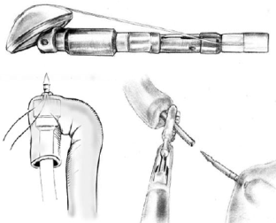
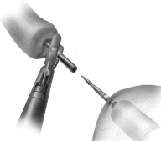
Literature review
Reconstruction
ROBOTIC TOTAL GASTRECTOMY
Mechanical anastomosis
Entirely manual suturing
End-to-Side
Side-to-Side
Circular stapler
Anvil placement
Creation of the purse-string suture
Jiang
Liu
Kang - Hur
Parisi (Double Loop)
Linear stapler
Manual purse-string suture
The anvil is introduced in the esophagus after performing a manual purse-string. The shaft of the stapler is introduced in the jejunal limb through an incision, and then the two sides are stapled together.
Using the OrVil™
The anvil is delivered trans-orally and the anastomosis is performed using the shaft of a stapler introduced through the jejunal stump.
Overlap technique
The linear stapler is introduced through a jejunal incision and the esophagus.
The two ends are stapled together and the remaining orifice is sewn manually.
Giulianotti
D’annibale
Vasilescu
Suda
Vasilescu
Notes:
However, the question is, how do you perform a robotic esopho-jejunal anastomosis?
The literature has reported in most cases the execution of mechanical anastomosis, especially with circular staplers through performing a manual purse-string around the anvil.
Other solutions described the use of the Orvil or the overlap technique.
Only three authors reported intracorporeal sutures with completely robotic-sewn anastomosis. Among these, only Liu and Jiang provided a detailed description of this procedure.

Slide 24
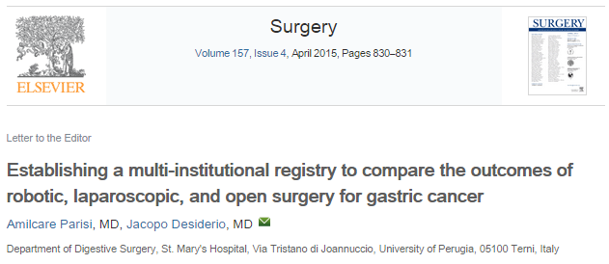
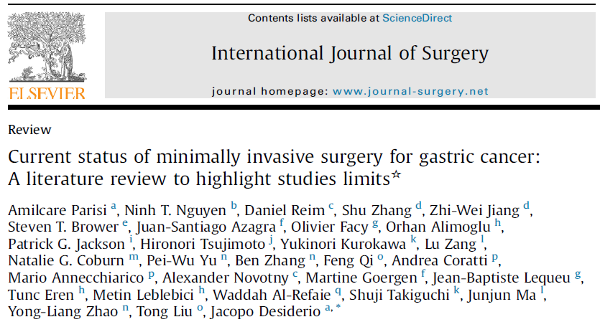
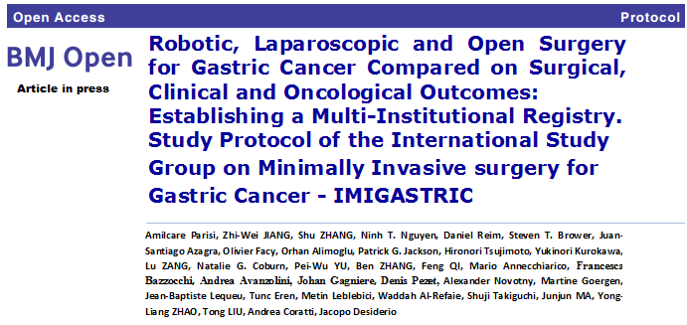
Future Perspectives
WHAT KIND OF STUDY?
Notes:
As we have seen, researchers must still explore many aspects of minimally invasive surgery for gastric cancer. We have a long way to go. Right now, the scientific community is wondering what strategies it should adopt in future studies.

Slide 25
More Information
www.imigastric.com
Parisi A, Desiderio J (2015) Establishing a multi-institutional registry to compare the outcomes of robotic, laparoscopic, and open surgery for gastric cancer. Surgery.
Parisi A, Nguyen NT, Reim D, Zhang S, Jiang ZW, Brower ST, Azagra JS, Facy O, Alimoglu O, Jackson PG, Tsujimoto H, Kurokawa Y, Zang L, Coburn NG, Yu PW, Zhang B, Feng Q, Coratti A, Annecchiarico M, Novotny A, Goergen M, Lequeu JB, Eren T, Leblebici M, Al-Refaie W, Takiguchi S, Junjun MA, Zhao YL, Liu T, Desiderio J (2015) Current Status of Minimally Invasive Surgery for Gastric Cancer:a literature review to highlight studies limits. Int J Surg.

