Slide 1
Robotic, Laparoscopic and Open Surgery for Gastric Cancer Compared on Surgical, Clinical and Oncological Outcomes: Establishing a Multi-Institutional Registry
IMIGASTRIC
International study group on Minimally Invasive surgery for Gastric Cancer
Project Manager: Amilcare Parisi
Notes:
First, I would like to thank the project manager, Dr. Parisi, and all the Investigators and Institutions involved in the IMIGASTRIC project.

Slide 2
Department of Digestive Surgery, St. Mary’s Hospital, University of Perugia. Terni, Italy.
PI: Amilcare Parisi
Co-Investigators: Jacopo Desiderio, Stefano Trastulli, Roberto Cirocchi
Chirurgische Klinik und Poliklinik, Klinikum Rechts der Isar der Technischen Universität München. München, Germany.
PI: Daniel Reim
Co-Investigators: Alexander Novotny
Division of Oncological and Robotic Surgery, Department of Oncology, Careggi University Hospital. Florence, Italy.
PI: Andrea Coratti
Co-Investigators: Mario Annecchiarico
Unité des Maladies de l’Appareil Digestif et Endocrine (UMADE), Centre Hospitalier de Luxembourg. Luxembourg.
PI: Juan-Santiago Azagra
Co-Investigators: Martine Goergen
Service de chirurgie digestive et cancérologique CHU Bocage. Dijon, France.
PI: Olivier Facy
Co-Investigators: Jean-Baptiste Lequeu
Department of General Surgery, Division of General, Gastroenterologic and Minimally Invasive Surgery, G.B.Morgagni Hospital. Forlì. Italy.
PI: Francesca Bazzocchi
Co-Investigator: Andrea Avanzolini
Digestive and Hepatobiliary Surgery Department. University of Auvergne, University Hospital Estaing. Clermont-Ferrand, France.
PI: Johan Gagniere
Co-investigators: Denis Pezet, Olivier Antomarchi
Notes:
All of them have made great efforts for the opening of the study, just two weeks ago.

Slide 3
Unit of minimally invasive and endocrine surgery, Center of oncologic minimally invasive surgery (COMIS), Careggi University hospital. Florence, Italy.
PI: Fabio Cianchi
Co-Investigators: , Benedetta Badii
Esophageal Surgery Unit, Tuscany Regional Referral Center for the Diagnosis and Treatment of Esophageal Disease, Medical University of Pisa. Pisa, Italy.
PI: Simone D’Imporzano
Department of General Surgery, Jinling Hospital, Medical School, Nanjing University. Nanjing, P.R.China.
PI: Zhi-Wei JIANG
Co-Investigator: Shu ZHANG
Department of General Surgery, School of Medicine, Istanbul Medeniyet University. Istanbul, Turkey.
PI: Orhan Alimoglu
Co-Investigator: Tunc Eren, Metin Leblebici
Department of Surgery, National Defense Medical College. Tokorozawa, Japan.
PI: Hironori Tsujimoto
Department of Gastroenterological Surgery, Osaka University Graduate School of Medicine. Osaka, Japan.
PI: Yukinori Kurokawa
Co-Investigator: Shuji Takiguchi
Department of Surgery, Ruijin Hospital, Shanghai Jiaotong University, School of Medicine. Shanghai, P.R. China.
PI: Lu ZANG
Co-Investigator: Junjun MA
Department of General Surgery, Third Military Medical University Southwest Hospital. Chongqing, P.R. China.
PI: Pei-Wu YU
Co-Investigators: Ben ZHANG, Yong-Liang ZHAO
Gastrointestinal Surgery, Tianjin Medical University General Hospital. Tianjin, P.R. China
PI: Feng QI
Co-Investigator: Tong LIU
Division of General Surgery, Sunnybrook Health Sciences Centre. Toronto, Canada.
PI: Natalie G. Coburn
Department of Surgery, Division of Gastrointestinal Surgery, University of California, Irvine Medical Center. Orange CA, USA.
PI: Ninh T Nguyen
Division of General Surgery, Division of Surgical Oncology, Medstar Georgetown University Hospital. Washington DC, USA.
PI: Patrick G. Jackson
Co-Investigator: Waddah Al-Refaie
Department of Surgery, Mount Sinai Beth Israel Medical Center. New York NY, USA.
PI: Steven T. Brower
Notes:
The poster, that I am presenting, summarizes all the challenging work that has been done for the conception, design and development of the Imigastric project up to the official opening of this international registry and future perspectives.

Slide 4
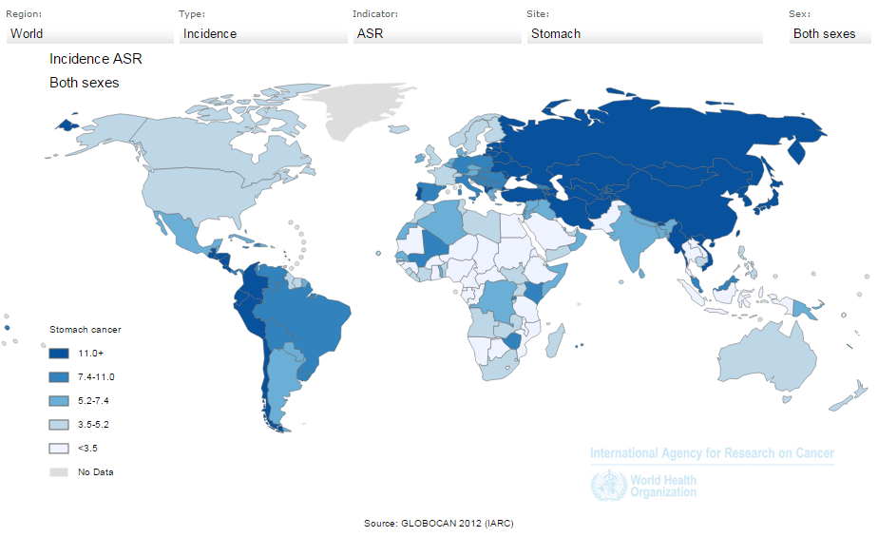
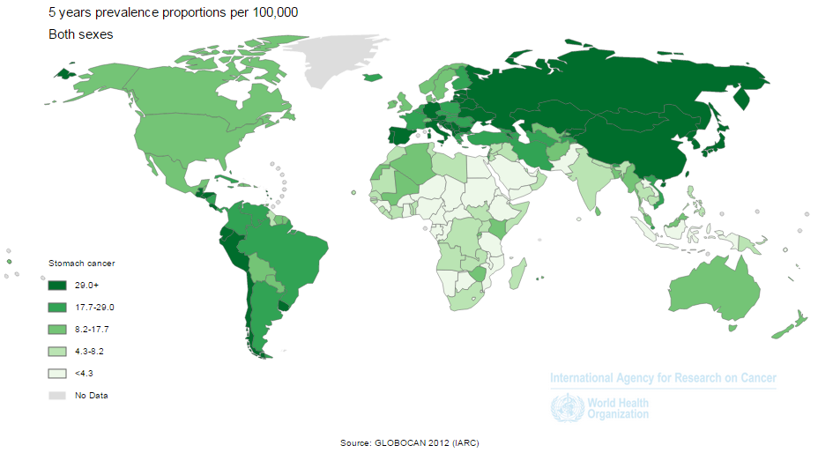
BACKGROUND
Gastric cancer is the fourth most common malignancy and the second leading cause of cancer death in the world.
Notes:
Gastric cancer is a major worldwide challenge.

Slide 5
BACKGROUND
Endoscopic submucosal dissection under expanded criteria
Adjuvant chemotherapy using agents other than S-1
INVESTIGATIONAL TREATMENTS
Local tumor resection
Adjuvant chemoradiotherapy
should be evaluated in appropriate clinical research settings
Neoadjuvant chemotherapy
Neoadjuvant chemoradiotherapy
Minimally Invasive Surgery
Notes:
There are many current areas of research being undertaken to identify the best treatment strategies. Among these is a steadily emerging interest in minimally invasive surgery thanks to continual technological developments.

Slide 6
RATIONALE
Research in Minimally Invasive Surgery
Perioperative outcomes
Quality of life
Respect of oncological principles
Growing attention in gastric cancer
Current level of evidence very low
6 RCTs comparing laparoscopic versus open gastrectomy
No RCTs have been performed for robotic surgery
Heterogeneity of studies
Notes:
Research in this field, particularly, seeks to assess the effects on perioperative outcomes along with the quality of the patient’s life, while still respecting oncological principles. The increasing attention being paid to these approaches unfortunately comes up against the limited data available to date, which prevents the scientific community from being able to develop specific guidelines.

Slide 7
RATIONALE
LAPAROSCOPIC SURGERY
ROBOTIC SURGERY
Technically feasible procedure
Technological advantages due to new articulated tools and 3D vision
Safety demonstrated for EGC at referral centers
Accuracy of the preoperative diagnosis
Surgeon’s experience and skill with MIS technology
Surgeon’s volume of gastrectomy procedure
Highlighted Issues
Reconstruction
Hospital’s volume
Extended lymphadenectomy
Notes:
In the past studies, very few questions were answered, and few suggestions arose, whereas many issues have since become the subject of debate.

Slide 8
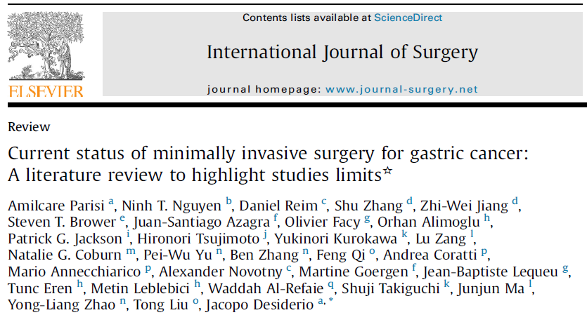
RATIONALE
Main limits found in
current clinical studies
Small samples of patients, few high-quality comparative studies.
Selection bias in generating the comparative groups: stage of the disease, different extensive surgeries.
Lack of clarity in the description of anastomotic techniques
Results of intracorporeal anastomosis are often mixed with those of extracorporeal anastomosis.
Anastomotic leak rate, in some studies, was twice as high after MIS procedures than OG, but there is a lack of information on the method of reconstruction.
There are significant discrepancies between studies concerning the length of hospital stay and postoperative management of patients.
In several centers, the decision to receive RG vs LG is made by the patient that incurs the extra expense for robotic surgery.
Notes:
Our project started from an analysis of the literature. Significant studies limitations were found:
- Small samples of patients.
- Selection bias.
- Absence of subgroup analysis in significant research fields.
- Lack of information on the surgical techniques adopted.

Slide 9
RATIONALE
WHAT KIND OF STUDY?
Large sample of patients
CONSISTENCE
Detection of numerous surgical, clinical and oncological variables
CLARIFYING KEY ISSUES
Predetermined and standardized method of data collection and analysis.
ENSURING ACCURACY
Bringing together the experience of the East and West
REPRESENTATIVENESS OF DATA
A multicenter registry may represent the best research method
to assess the role of minimally invasive approaches in gastric cancer
Notes:
What kind of study can be helpful in this context?
It is necessary:
-A large sample of patients,
-The collection of multiple variables,
-The standardization of the methodology,
-Bringing together the experience of East and West, finding shared points.
A large multicenter registry could therefore be the best way to clarify the actual role of minimally invasive surgery.

Slide 10
METHODS
Recruitment Strategy
254 potential investigators were identified from the literature review
Invitation letter by the Department of Digestive Surgery “Dt. Mary’s Hospital” of Terni
All of the corresponding authors of the selected articles were contacted via e-mail
No valid E-mail address: senior investigator contacted
No response received: second e-mail sent one week later
No response, no other addresses: fax sent to the Institution
No response after 3 weeks: other listed investigator contacted
At the end of the search, 18 centers in 10 different countries worldwide provided positive feedback and agreed in taking part in the creation of a Multi-institutional database.
Notes:
Therefore, in April 2014, we started from the previously performed analysis of the literature to identify centers potentially interested in a such a project. An invitation letter was sent to the corresponding authors of the selected articles. At the end of the screening period, 18 centers sent positive feedback.

Slide 11
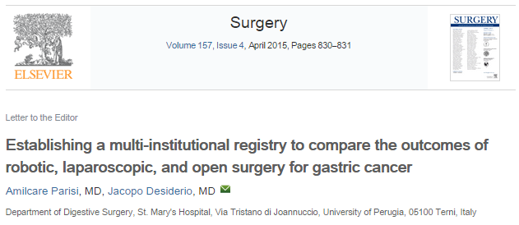
METHODS
INSTITUTIONS REACHED
AN AGREEMENT
Principles of the study
Objectives
Data to be collected
Software tools
Join databases
Compare all the current surgical approaches
Contribution on gastric cancer research
DEVELOPMENT AND SHARING A STUDY PROTOCOL
Notes:
Over the following months, an agreement was reached among involved researchers and on this basis, a study protocol was developed.

Slide 12
METHODS
General study design
OVERALL PURPOSE
Develop and maintain an ongoing comprehensive multi-institutional database comprising of information regarding surgical, clinical and oncological features of patients undergoing surgery for gastric cancer with robotic, laparoscopic or open approaches and subsequent follow-up at participating centers.
The Main Objectives
To determine the surgical, clinical, and oncological outcomes in both the short and long term
To compare results according to the type of intervention, device used and manner of execution of different surgical phases
To relate results of different surgeries with baseline characteristics of patients and stage of disease
Notes:
The study’s overall objective is to establish and maintain a multi-institutional database comprising information on the surgical, clinical, and oncological features of patients undergoing gastrectomy with a robotic, laparoscopic, or open approach.

Slide 13
METHODS
General study design
TYPE OF STUDY
Different steps with an increasing level of scientific evidence were planned.
First Step: Retrospective study – Chart Review
Data of subjects with gastric cancer treated at the participating centers. Information gathered will be obtained from existing records, diagnostic tests and surgical interventions description
Second Step: Prospective Trial
Enrollment will be opened to newly identified subjects into the registry upon diagnosis and treatment in a prospective manner.
Notes:
The project, which has started, includes an initial retrospective phase, including data arising from a review of existing medical records. Then, from the experience accumulated during this phase, a prospective trial could begin.

Slide 14
METHODS
Specific aims
AIM 1: To compare robotic and laparoscopic surgery to the open approach in terms of safety and feasibility based on the intraoperative and postoperative outcomes.
AIM 2: To verify the respect of oncological principles through minimally invasive approaches in relation to the stage and location of the tumor by comparing results to open surgery.
AIM 3: To verify whether minimally invasive approaches ensure the same effectiveness as open surgery in terms of overall survival and disease-free survival.
AIM 4: To compare the three treatment arms regarding recovery of gastrointestinal function considering the outcomes measured during the postoperative hospital stay.
AIM 5: To compare the incidence, types and severity of early postoperative complications after gastrectomy by the three approaches according to the Clavien-Dindo classification system
AIM 6: To compare the intracorporeal to the extracorporeal anastomosis to evaluate post-operative recovery and complications.
AIM 7: To verify whether robotic gastrectomy, compared to laparoscopic or open techniques, is capable of reducing postoperative surgical stress.
Notes:
Seven specific aims of interest have been identified comparing different surgeries.

Slide 15
METHODS
Eligibility
Every patient is required to meet all of the
inclusion criteria and none of the exclusion criteria
Inclusion criteria
Histological proven grastic cancer
Preoperative staging work-up performed in accordance to international guidelines
Early Gastric Cancer
Advanced Gastric Cancer
Patients treated with curative intent in accordance to international guidelines
Patients with positive peritoneal cytology can be considered
Exclusion criteria
Distant metastases: peritoneal carcinomatosis, liver metastases, distant lymph node metastases, Krukenberg tumors, involvement of other organs
Patients with high operative risk as defined by the Americans Society of Anesthesiologists (ASA) score > 4
History of previous abdominal surgery for gastric cancer
Synchronous malignancy in other organs
Palliative surgery
Notes:
Patients will be considered based on inclusion and exclusion criteria.

Slide 16
METHODS
Data collection
Patient Demographics
Sex, age, BMI, ASA score, concomitant illness, previous abdominal surgery.
Surgical Procedure details
Type of surgical approach: open, laparoscopy, robotic
Gastric resection and type of reconstruction
Anastomosis approach: intra-corporeal, extra-corporeal
Anastomosis performance: linear stapler, circular stapler, hand-sewn, robot-sewn
Extent of lymphadenectomy: D1, D1+, D2, D2+
Duration of surgery, blood loss, intraoperative complications
Number of retrieved lymph nodes, margin free of disease or infiltrated.
Tumor characteristics
Tumor location: Upper third, Middle third, Lower third.
Depth of invasion (T classification), lymph node status (N classification), AJCC pathological stage, Histological type and Lauren classification
Notes:
For data collection, six categories were identified:
-patient characteristics.
-surgical procedure details.
-tumor characteristics.

Slide 17
METHODS
Data collection
Post-operative clinical findings
Time to start oral intake
Resumption of bowel function
Length of postoperative hospital stay
Post-operative complications
Type and grade of in-hospital complications
Surgical complications after discharge
Follow-up details
Patient alive, not alive or lost at follow-up
Disease-free or not at follow-up
Time to onset of recurrence and site of recurrence
Notes:
-Data on the postoperative period.
-Surgical complications.
-Details of oncological follow-up.

Slide 18
METHODS
Primary outcome measures
Safety and feasibility of minimally invasive procedures: rate of intraoperative complications, rate of conversion to open surgery, estimated blood loss.
Respect of oncological principles: number of lymph nodes retrieved and rate of patients achieving R0 resection, at the histopathological analysis of the surgical specimen.
Effectiveness of surgery: overall survival and disease–free survival achieved at 1, 3, 5 years from surgery.
Notes:
From the collected data seven outcomes will be calculated and compared.
Three primary outcomes.

Slide 19
METHODS
Secondary outcome measures
Recovery of gastrointestinal functions and physical status allowing the discharge of the patient: time to peristalsis, time to first flatus, time to start oral intake and days of hospitalization after surgery until discharge.
Early postoperative complications: rate of total complications, rate of specific surgical complications, severity of complications scored on the Clavien-Dindo classification system, assessed during hospitalization.
Safety and efficacy of intracorporeal anastomosis: rate of anastomotic leakage, days of hospitalization after surgery until discharge.
Postoperative surgical stress: Granulocyte-to-lymphocyte ratio recorded and compared before and after surgery.
Notes:
Four secondary outcomes.

Slide 20
METHODS
Study period and sites
The chart review for the registry takes into account all available data of patients treated at the participating Centers between the 1st January 2000 and the official opening of the Registry (14th May 2015).
It is expected to make a first interim analysis by December 2015.
The study started at the original 18 sites.
Other centers can join the study.
Sample size calculation
It is estimated from recent meta-analyses that the rate of procedures performed with minimally invasive surgery at referral institutes for gastric cancer, considering patients who follow inclusion and exclusion criteria of this protocol, is of 35%.
According to the number and volume of the participating centers and to reach a sample of 2800 subjects treated with laparoscopic or robotic surgery, is estimated that data of at least 8000 patients need to be collected.
Notes:
The study considers patients treated from January 1, 2000, to the official opening of the registry.

Slide 21
TOOLS
The imigastric software
Standardize data collection
Avoiding transmission errors
Security of sensitive data
PROTECTED WEB SOFTWARE
Automatic statistics
Managing entered cases
Sharing
of data
Notes:
The great innovation introduced in this type of study concerns the adopted tools. An IT instrument was created thanks to close cooperation with experts in software development. Combining medical and engineering expertise led to the development of a unique and tailored instrument. This makes it possible to facilitate and standardize data collection, speed up the creation of a shared database, and ensure the security of sensitive data.

Slide 22
TOOLS
The imigastric software
The IMIGASTRIC software is an ERP (Enterprise Resource Planning) advanced system structured with specific sections dedicated to clinical data management and implementing processes.
The platform was designed by balancing the exigency to implement the application according to "Good Clinical Practice" and the need it is user friendly and safe.
Various access profiles (user, administrator), each of which are authorized to display specific information for tailored management.
Notes:
The creation of a multi-institutional registry leads to many problems needing to be addressed.
The investigators are in different parts of the world. As such, there is a high risk of transmission errors’ being generated during the various steps of collecting and sending data. Therefore, the main purpose was to make data entry user friendly.
The software has some principle characteristics, such as: different levels of user profiles, each center has its own independent management, all the data are collected in a global registry, you can obtain statistics on your center, as well as on the overall database.

Slide 23
TOOLS
The imigastric software
Advanced software technology: complete management of the IMIGASTRIC registry in RDE (Remote Data Entry) mode, possible by exploiting broad band (ISDN, ADSL) Internet connection.
Any activity required by investigators can be performed through an application available online and accessible via a specific Internet address.
Through the activation of particular analysis tools, it is possible to obtain data in real time.
Assurance of data quality and safety. Monitoring of the quality of data written in electronic formats.
Notes:
Moreover:
1. Data entry of patients complies with the most stringent privacy regulations.
2. For each patient, the system generates a reference code and an IT folder.
3. The software is designed to guide the user in data entry.
4. The different fields are filled in by selecting the various options from drop-down menus.
5. The software uses predefined control instruments and automatic calculations.

Slide 24
FINANCING OF THE STUDY
The IMIGASTRIC project is supported by CARIT Foundation (Fondazione Cassa di Risparmio di Terni e Narni), an organization that supports nonprofit research for the St. Mary’s Hospital of Terni and University of Perugia. Grant number: 0024137, approved 12/11/2014.
Notes:
The project earned a grant as a nonprofit study, provided by the CARIT Foundation, which will allow the registry to be kept open at least until the beginning of 2018.

Slide 25
MORE INFORMATION
www.imigastric.com
#imigastric
Parisi A, Desiderio J (2015) Establishing a multi-institutional registry to compare the outcomes of robotic, laparoscopic, and open surgery for gastric cancer. Surgery.
Parisi A, Nguyen NT, Reim D, Zhang S, Jiang ZW, Brower ST, Azagra JS, Facy O, Alimoglu O, Jackson PG, Tsujimoto H, Kurokawa Y, Zang L, Coburn NG, Yu PW, Zhang B, Feng Q, Coratti A, Annecchiarico M, Novotny A, Goergen M, Lequeu JB, Eren T, Leblebici M, Al-Refaie W, Takiguchi S, Junjun MA, Zhao YL, Liu T, Desiderio J (2015) Current Status of Minimally Invasive Surgery for Gastric Cancer:a literature review to highlight studies limits. Int J Surg.
Notes:
You can obtain further information by visiting the study website: www.imigastric.com, where a form to contact the organizing secretariat and the coordinating staff is available.
You can also use social networks to follow the news and the daily updates on the project and to interact with investigators.
Interested researchers are invited to join us.

